Slide 1
HTML TAGS
MCNDHS
Ms. Eng

Slide 2
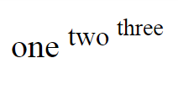
AIM: HOW DO WE WRITE LINKS IN HTML?
Do now: Try to recreate this on codepen.io
Daily Grade:
On-time/attendance/not leaving the classroom: 25%
Cellphones: 25%
Notes:25%
Classwork/Homework: 25%

Slide 3
WHAT IS A LINK
A connection that links the user to one of the following:
A webpage outside of your repository (Another webpage that’s not yours)
A webpage within your repository
A part of a webpage (ex: back to top)
To another application (pop-ups)

Slide 4
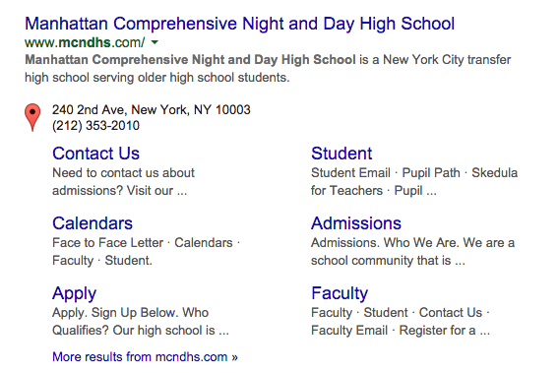
TO ANOTHER WEBPAGE

Slide 5
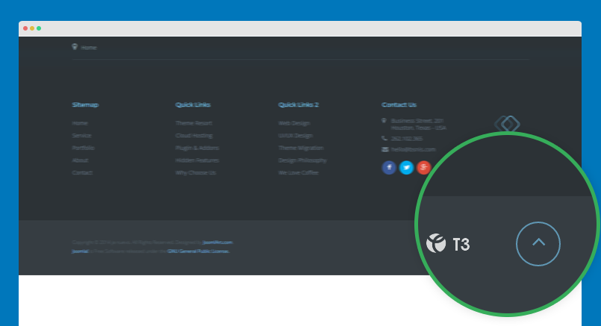
TO ANOTHER SECTION

Slide 6
EXAMPLE: LINKING TO ANOTHER WEBSITE
Opening tag:
<a href=“ insert your link here”> write a title for your link
Closing tag:
</a>

Slide 7


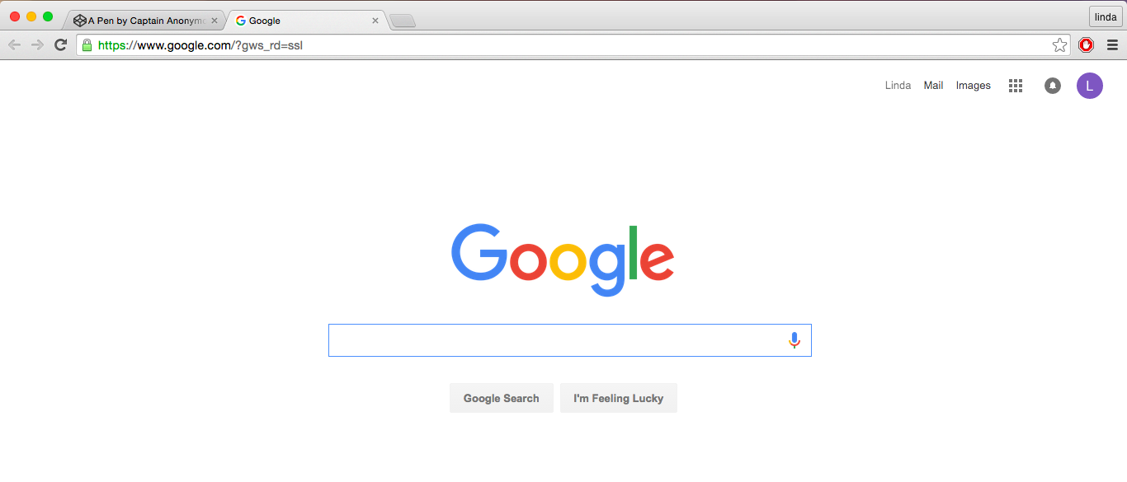
STEP-BY-STEP

Slide 8


GOOD PRACTICE
When you are linking a website, you should write the description of where you will be taking your user instead of just writing “click here”

Slide 9
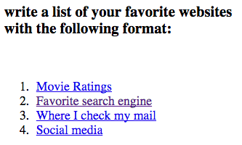
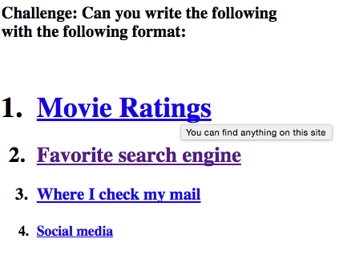
ACTIVITY

